Slide 1

Tax Incentives in Belgium
2017
Federal
Public Service
Finance
Michela Ritondo
Fiscal Department for Foreign Investments
January 2017

Slide 2

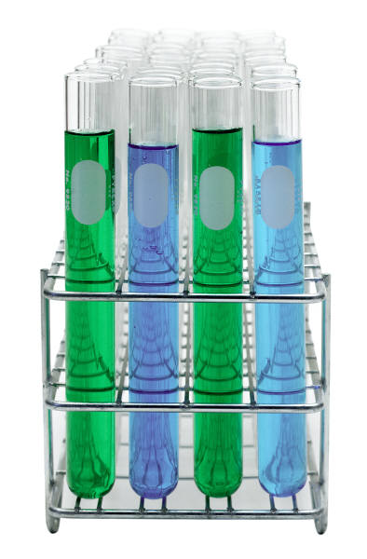

Research – Development - Innovation
Innovation Income Deduction
What
85% deduction from Innovation net income
➔ = 5,1% effective tax rate
Qualifying
IP rights
- Patents (self-developed or acquired)
Supplementary protection certificates
Plant variety rights & orphan drug rights
Copyrighted software (resulting from an R&D project)
- Not: Marketing intangibles (brands) and other IP rights
FISCAL DEPARTMENT FOR FOREIGN INVESTMENTS

Slide 3
Research – Development - Innovation
Innovation Income Deduction
Qualifying
IP Income
-License fees
-IP income embedded in sales price or in production process
-Compensation for damages of IP rights infringements (court, arbitration, insurance, settlement)
-Capital gains (on transfer of self-developed IP asset or acquired IP asset), on condition of reinvestment in qualifying expenses within 5 years
On Net
Qualifying
IP Income
Gross qualifying IP Income
(-) the overall R&D expenditure
FISCAL DEPARTMENT FOR FOREIGN INVESTMENTS

Slide 4
Research – Development - Innovation
Deduction
rate
of 85%
Innovation Income Deduction
Application of Nexus ratio (OECD and EU rules)
➔ Formula:
IID = Net IP Income x Nexus ratio x 85 %
Income receiving tax benefits:
Net IP Income x Qualifying R&D expenses x 1,3 (X 85%)
Overall R&D expenses
FISCAL DEPARTMENT FOR FOREIGN INVESTMENTS

Slide 5
Research – Development - Innovation
Innovation Income Deduction
Income
receiving
tax benefits
Net IP Income x Qualifying R&D expenses x 1,3
Overall R&D expenses
- Deduction of overall expenditures : own R&D expenses, acquisition expenditures (remunerations, depreciations);
- Not: expenditures not directly related to the development/acquisition (interest, real estate expenses,…)
- Deduction of prior-year expenditures (recapture of expenses incurred during taxable periods ending after 30.06.2016)
Net
IP Income
FISCAL DEPARTMENT FOR FOREIGN INVESTMENTS

Slide 6
Research – Development - Innovation
Innovation Income Deduction
Income
receiving
tax benefits
Net IP Income x Qualifying R&D expenses x 1,3
Overall R&D expenses
R&D expenditure incurred by the taxpayer, included outsourcing to unrelated parties
Not: acquisition expenditures
Not: outsourcing to related parties (except for expenditures passed on without margin)
➔ If IP right self-developed : all expenditure is qualifying ➔ 100% entitlement to innovation deduction
Qualifying
R&D
expenses
FISCAL DEPARTMENT FOR FOREIGN INVESTMENTS

Slide 7
Research – Development - Innovation
Innovation Income Deduction
Income
receiving
tax benefits
Net IP Income x Qualifying R&D expenses x 1,3
Overall R&D expenses
Qualifying R&D expenses
Qualifying R&D expenses
+
Non-qualifying R&D expenses : outsourcing to related parties, acquisition expenditures
Overall
R&D
expenses
FISCAL DEPARTMENT FOR FOREIGN INVESTMENTS

Slide 8
Research – Development - Innovation
Innovation Income Deduction
Income
receiving
tax benefits
Net IP Income x Qualifying R&D expenses x 1,3
Overall R&D expenses
30% uplift on qualifying expenditure (max overall expenditure)
Possible derogation if taxpayer can demonstrate that, due to exceptional circumstances, the nexus ratio does not correctly reflect the value of the internal R&D
Condition: min. nexus ratio of 25% (excl. uplift)
Tax ruling + exchange of information
X 1,3
FISCAL DEPARTMENT FOR FOREIGN INVESTMENTS

Slide 9
Research – Development - Innovation
Innovation Income Deduction
Income
receiving
tax benefits
Net IP Income x Qualifying R&D expenses x 1,3
Overall R&D expenses
Qualifying IP Income must be related to the qualifying IP right of the taxable period
Documentation requirements: amount of the qualifying IP income, qualifying and overall expenditures,,,,
Calculation for each IP right separately
If not practical : calculation by product/service, or group of products/services
Tracking
and
Tracing
FISCAL DEPARTMENT FOR FOREIGN INVESTMENTS

Slide 10
Research – Development - Innovation
Innovation Income Deduction
  - IP rights owned as owner, co-owner, usufruct or
  rights holder
  - Self-developement or improvement of acquired IP rights
  (exception: copyrighted software)
  - IP right obtained in any juridiction
Highlights
IP Rights
FISCAL DEPARTMENT FOR FOREIGN INVESTMENTS

Slide 11
Research – Development - Innovation
Innovation Income Deduction
  - IID applicable as of patent request
  - IID applicable to income which is included in the
  Belgian taxable base
  (Not: income in tax base of foreign PE)
  - Any excess IID can be carried forward
  - No R&D center requirement, but obligation of
  documentation (+ Transfer Pricing considerations)
  - Combination with other R&D tax incentives
Highlights
Innovation
Income Deduction
(IID)
FISCAL DEPARTMENT FOR FOREIGN INVESTMENTS

Slide 12
1/ Déduction pour revenus d’innovation: exemple
Federal
Public Service
Finance
Revenus bruts de brevets: EUR 400.000
Dépenses qualifiantes (= dépenses totales R&D) EUR 100.000
Revenus nets de brevets: 400.000 - 100.000 = EUR 300.000
Limite NEXUS : Numérateur : EUR 100.000
Dénominateur: EUR 100.000
Revenus d’innovation à prendre en considération : 300.000 x 100/100 = EUR 300.000
Déduction pour revenus d’innovation : EUR 300.000 x 85% = EUR 255.000
Revenus imposables: EUR 400.000 – 255.000 = EUR 145.000
Impôt des Sociétés: EUR 145.000 x 33,99% = EUR 49.285

Slide 13
1/ Déduction pour revenus d’innovation: exemple
Federal
Public Service
Finance
Revenus bruts de brevets: EUR 400.000
Dépenses qualifiantes: EUR 100.000
Amortissement brevet (en 5 ans): EUR 10.000
Dépenses R&D entreprise associée: EUR 40.000
Dépenses totales PI : - EUR 150.000
Revenus nets de brevets: 400.000 - 150.000 : EUR 250.000
Limite NEXUS : Numérateur : EUR 100.000 x 130% = EUR 130.000
Dénominateur: EUR 150.000
Ratio: 130.000 / 150.000 = 86,7%
Revenus d’innovation à prendre en considération : EUR 250.000 x 86,7% = EUR 216.000
Déduction pour revenus d’innovation : EUR 216.000 x 85% = EUR 183.600
Impôt des Sociétés: 400.000 – 183.600 = EUR 216.400 x 33,99% = EUR 73.418

Slide 14
Research – Development - Innovation
R&D Tax Credit
What
13,5% (of the investment value)
Assets which aim to promote R&D of new products and advanced technologies environment-friendly
Investment of 100.000 €
Tax credit = 100.000 x 13,5% x 33,99% = 4.588 €
In case of insufficient profits, the part not used after 5 years is refunded
Advantage
FISCAL DEPARTMENT FOR FOREIGN INVESTMENTS

Slide 15

Research – Development - Innovation
Investment Deduction
All companies:
  13.5% for
    patents ,
    energy efficient investments,
    environmental friendly investments for research and development and smoke exhaust
    aeration systems in the hotel and catering industry,
  3% for investments encouraging the reuse of packaging materials for beverages and industrial products
Deductible part
FISCAL DEPARTMENT FOR FOREIGN INVESTMENTS

Slide 16
Research – Development - Innovation
Investment Deduction
SME Companies (Art. 15 of the Belgian CC):
  20.5% for investments in security
  13,5% for investments in digital fixed assets (invoicing, payment- and security systems)
  8 % for
    other investments directly related to the actual economic activity of the company(only applicable if the company irrevocably waived the notional interest deduction),
    investments encouraging the reuse of packaging materials for beverages and industrial products
Deductible part
FISCAL DEPARTMENT FOR FOREIGN INVESTMENTS

Slide 17
Research – Development - Innovation
Investment Deduction
  E-commerce, investments in software or assets that
    Simplify electronic payments
    Are used for electronic invoicing, signature or archival use
  Cybersecurity
    Software or assets used for securing information, networks, ICT-installations
    Monitoring and audit of ICT-security
    Software and assets on personal individual data protection
  Other investments used for the execution of e-commerce a and e-security (software, interfacing, …)
Digital fixed assets
FISCAL DEPARTMENT FOR FOREIGN INVESTMENTS

Slide 18
Research – Development - Innovation
Investment Deduction
Basis for the calculation
the acquisition or investment value of the fixed assets which also is the basis for the calculation of the depreciations
Investment | 100
Depreciation period | 3 years
Year | 1 | 2 | 3
Depreciation | 33,3 | 33,3 | 33,3
Investment deduction (one go) | 13,5
Fiscal deduction | 46,5 | 33,3 | 33,3 | 113,5
FISCAL DEPARTMENT FOR FOREIGN INVESTMENTS

Slide 19
Research – Development - Innovation
Investment Deduction
Spread deduction
All companies 20,5% :
environmental friendly investments for research and development
Investment | 100
Depreciation period | 3 years
Year | 1 | 2 | 3
Depreciation | 33,3 | 33,3 | 33,3
Investment deduction (one go) | 13,5
Fiscal deduction | 48,5 | 33,3 | 33,3 | 113,5
Investment deduction (spread) | 6,83 | 6,83 | 6,83
Fiscal deduction | 40,16 | 40,16 | 40,16 | 120,5
FISCAL DEPARTMENT FOR FOREIGN INVESTMENTS

Slide 20
Research – Development - Innovation
Partial exemption Withholding Tax researchers
Principle
The withholding tax is normally retained on the remuneration paid to the researchers, but the employers are exempted from paying a part to the Belgian Treasury (more financial resources for the research activities)
Researchers
Master degree or equivalent, engaged in a R&D program
Consequence
Exemption of 80% of the withholding tax
FISCAL DEPARTMENT FOR FOREIGN INVESTMENTS

Slide 21

Example
Research – Development - Innovation
Partial exemption Withholding Tax researchers
  Gross salary 6.000€
  Net salary Withholding tax
  4.000 € 2.000 €
  20% = 400€
  (80% exemption)
  Cost for the company = 6.000€
  Cost for the company = 4.400€
FISCAL DEPARTMENT FOR FOREIGN INVESTMENTS

Slide 22

Research – Development - Innovation
Tax allowance additional employee
Who
the manager of Total Quality department
the manager of Export department
Consequence
Exemption of 15.360 € (Tax Year 2017) from the enterprises profits
FISCAL DEPARTMENT FOR FOREIGN INVESTMENTS

Slide 23

Research – Development - Innovation
Innovation premium
What
Creative employee (new idea - added value)
Consequence
Social and fiscal exemption
One month’s salary
FISCAL DEPARTMENT FOR FOREIGN INVESTMENTS

Slide 24


Federal
Public Service
Finance
Logistics
European Distribution Center
PARENT COMPANY e.g.
USA / Japan…
Belgian DISTRIBUTION Centre
Belgian SERVICES Centre
Operational Companies
Operational
Companies
Cost plus % case-by-case ruling *
* OECD accepted norm: arm’s length standard
FISCAL DEPARTMENT FOR FOREIGN INVESTMENTS

Slide 25
Logistics
European Distribution Centre
Income approved by the ruling Commission (ex. 105% of operational exp.)
➔ mark up 5% on operational expenses
Expenses
Transport (27.000 €)
Warehousing (27.000 €)
Staff (46.000 €)
Income
Interco Reinvoicing
European Distribution Centre
100.000 €
105 % X 100.000 € = 105.000 €
Income 105.000 €
Expenses - 100.000 €
profit 5.000 €
Corporate tax rate 33,99 %
Corporate tax 1.700 €
FISCAL DEPARTMENT FOR FOREIGN INVESTMENTS

Slide 26
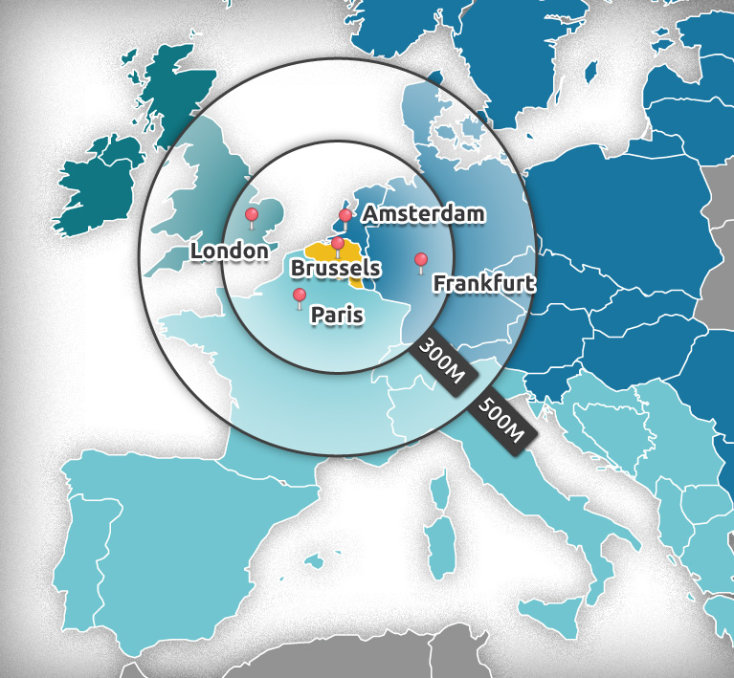
Logistics
European Union is a Customs Union
No customs duties on trade between EU Member States
No internal trade barriers
Common external tariff and harmonized trade measures
FISCAL DEPARTMENT FOR FOREIGN INVESTMENTS

Slide 27
Logistics
Tax perspective
Customs - Depiction
EU State
Customs duty
payable
Incoming goods
Bonded
Warehouse
Outgoing goods
No customs duty
payable
Non - EU State
No customs duty
payable
FISCAL DEPARTMENT FOR FOREIGN INVESTMENTS

Slide 28

Logistics
European Union is a VAT Union
VAT is due on
  Supply of goods and services
  Importation of goods
VAT is not a cost for the operators (deductible)
Cost-saving opportunity: VAT deferral (Belgium)
  Possibility to postpone the payment of import VAT to the next periodical VAT return
  Avoid pre-financing VAT (cash flow advantage)
  By simple request (ET 14000 license)
FISCAL DEPARTMENT FOR FOREIGN INVESTMENTS

Slide 29
Logistics
Tax perspective
VAT- Depiction
EU State
No input VAT
Incoming goods
Bonded Warehouse
or
VAT deferral
Outgoing goods
No input VAT
Non - EU State
No input VAT
FISCAL DEPARTMENT FOR FOREIGN INVESTMENTS

Slide 30

Finance
Holding regime
Participation exemption 95% deduction on dividends received
(min treshhold, min holding period)
100% deductibility of interest paid to acquire shares
0% capital duty on capital contribution
Capital gains on shares:
- 100% exemption for SME’s
- 0,412% taxation for large enterprises
(min holding period 12 months, taxation requirement)
Tax benefits
FISCAL DEPARTMENT FOR FOREIGN INVESTMENTS

Slide 31
Finance
Holding regime
Dividend Withholding Tax exemption
100% exemption
Conditions:
- be resident in a country with which Belgium has
concluded a double tax treaty;
- the beneficiary holds a participation of at least 10%
in a Belgian subsidiary, for an uninterrupted period
of at least 12 months
Tax benefits
FISCAL DEPARTMENT FOR FOREIGN INVESTMENTS

Slide 32
Tax incentives - Employment
Management | Expatriate status
Workers | Team work – Night shift
For all | Lower social contributions (Tax Shift)
FISCAL DEPARTMENT FOR FOREIGN INVESTMENTS

Slide 33
Tax Incentives for Employment
Expatriate tax regime
part of an international group
  a Belgian company
  a subsidiary, branch office or establishment of a foreign company
  a scientific research center or a coordination office
Conditions
Employer
FISCAL DEPARTMENT FOR FOREIGN INVESTMENTS

Slide 34
Tax Incentives for Employment
Expatriate tax regime
not a Belgian citizen
should exclusively perform activities which require a special knowledge (specialist) and/or responsibility, thus executive functions
the employment in Belgium should have a temporary nature
should demonstrate that he or she has maintained personal and economic ties abroad
assigned to Belgium by a foreign group company or has been recruited directly from abroad.
Conditions
Employee
FISCAL DEPARTMENT FOR FOREIGN INVESTMENTS

Slide 35
Tax Incentives for Employment
Expatriate tax regime
For the EMPLOYER
Reduction of employment cost for expats
FISCAL DEPARTMENT FOR FOREIGN INVESTMENTS

Slide 36

Tax Incentives for Employment
Travel exclusion : remuneration relating to the days worked outside of Belgium is not taxable
(personal income of non-Belgian source is not taxable in
Belgium)
Expatriate allowances or expense reimbursements are (partially) taxfree :
  Non-recurring expenses + school fees without any ceiling
  Expatriation allowances for repetitive expenses (cost of living, cost of housing, tax equalization) : tax free subject to an annual ceiling of EUR 11.250 or EUR 29.750 (The higher ceiling is applicable for activities of a controlling or coordinating nature or for scientific research)
For the EMPLOYEE
FISCAL DEPARTMENT FOR FOREIGN INVESTMENTS

Slide 37
Tax incentives for employment
Nightshift and Team work
Principle
Night shift and Team work (min 2 teams)
Continuous work( min 4 teams)
Partial exemption of payment of the withholding tax on the remunerations of workers in team work or night shifts
– 22.8% of the taxable salary for nightshift and teamwork (min 2 teams)
– 25% of the taxable salary for continuous work ( min 4 teams)
Advantage
FISCAL DEPARTMENT FOR FOREIGN INVESTMENTS

Slide 38
Example
Tax Incentives for Employment
Partial exemption withholding tax continuous work
  Taxable salary 2.600€
  Net salary Withholding tax
  1.690 € 910 €
  Exemption : 2 600 x 25% = 650 €
  Withholding tax to pay to the tax administration =
  910 - 650 = 260 €
FISCAL DEPARTMENT FOR FOREIGN INVESTMENTS

Slide 39

Tax Incentives for Employment
New 2016 : TAX SHIFT
Goal :
Strengthen the consumers spending power
Enhance competitiveness, investments and export
FISCAL DEPARTMENT FOR FOREIGN INVESTMENTS

Slide 40
Tax Incentives for Employment
New 2016 : TAX SHIFT
Achievement :
For the 1st recruitment : total exemption of the social contributions of the employer (recruitment between 1.01.2016 and 31.12.2020)
From 2nd to 6th recruitment : partial exemption
For all workforce : general reduction
social contributions should decrease from 33% (before 2016)
to 25% (in 2018)
FISCAL DEPARTMENT FOR FOREIGN INVESTMENTS

Slide 41

Tax ruling for legal certainty
The investor describes the facts to the tax administration, allowing him to know, in advance, how the tax laws are to be applied on a case by case basis
Principle
Consequences
Confidence to invest
Legally binding & accurate forecast
Scope of
applications
Corporate tax, individuals tax, customs, VAT, Transfer pricing, Business Restructuring, Deductible expenses Financing, Branches, Bonded warehouses, etc.
FISCAL DEPARTMENT FOR FOREIGN INVESTMENTS

Slide 42
Tax ruling for legal certainty
Transfer pricing issues
  Cost plus ruling for European Distribution Center (EDC) or for Service Sharing Center (SSC)
Taxable presence or not in Belgium ?
  In the hands of the foreign principal of a Belgian manufacturer or sales function
  In the hands of the service recipients of a EDC or SSC
Personal tax issues
  tax-free lump sum allowances for personnel
VAT issues
  VAT-unit
Examples
FISCAL DEPARTMENT FOR FOREIGN INVESTMENTS

Slide 43
Tax ruling for legal certainty
Prefiling meeting on anonymous base
Legal certainty for a 5 year period (renewable)
Advanced decision granted within the 3 months
Economic substance required
Characteristics
FISCAL DEPARTMENT FOR FOREIGN INVESTMENTS

Slide 44

Thank you for your attention
More information ?
Contact
Federal Public Service Finance
Fiscal Department for Foreign Investments
Rue de la Loi, 24 (Parliament Corner)
1000 Brussels - BELGIUM
Michela Ritondo
Email: michela.ritondo@minfin.fed.be
Phone: +32 257 938 69
Website: www.finances.belgium.be
FISCAL DEPARTMENT FOR FOREIGN INVESTMENTS

